Slide 1
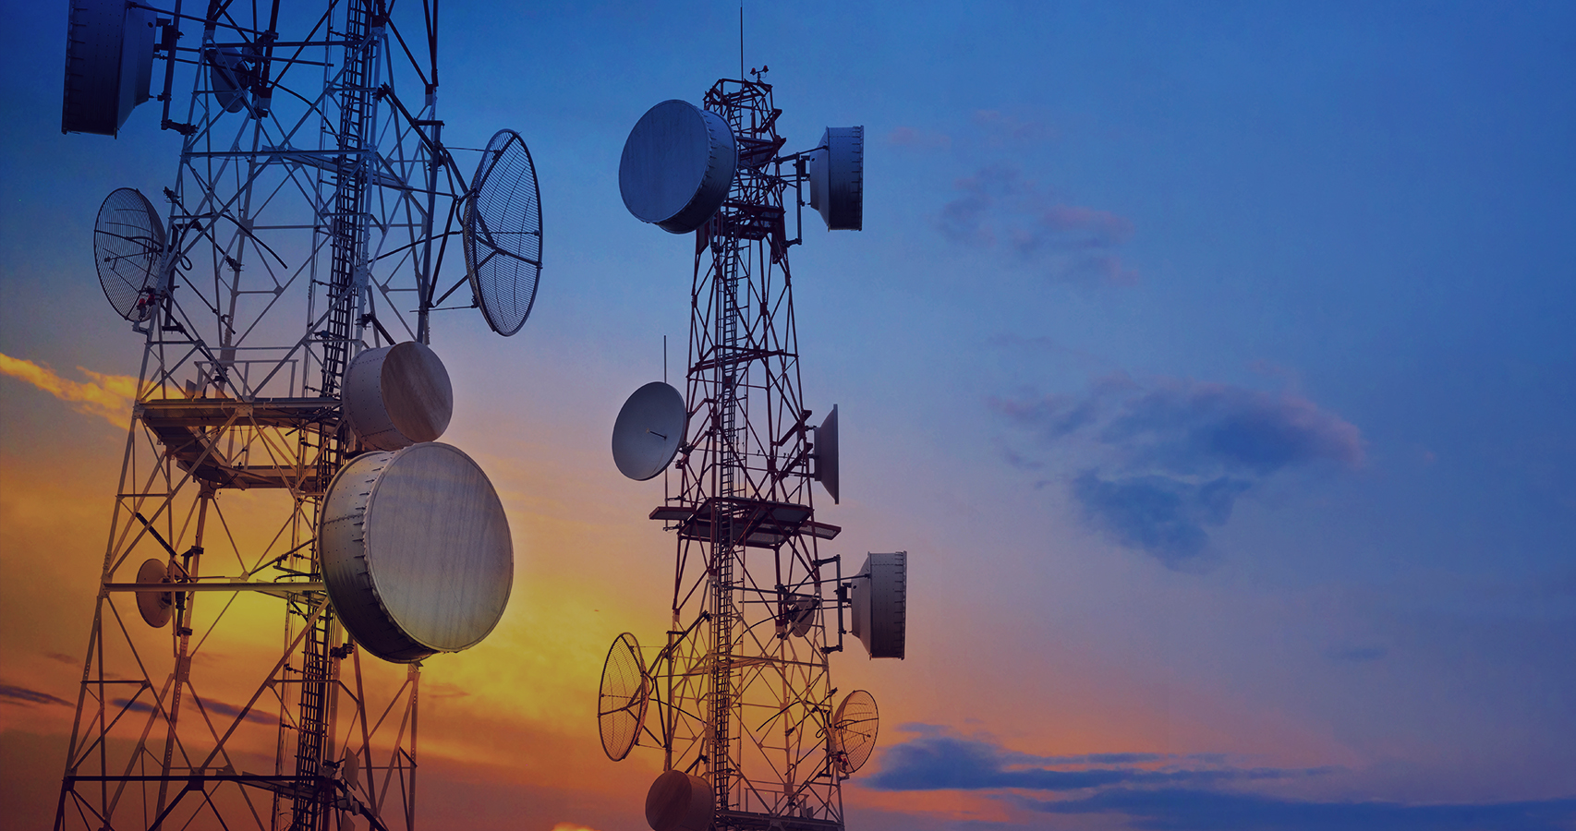
BAMBATEL CHURN CLASSIFICATION

Slide 2
BUSINESS PROBLEM
Most telecom companies suffer from voluntary churn. Churn rate has strong impact on the life time value of the customer because it affects the length of service and the future revenue of the company.
To Do
Determine features that cause churn, give recommendations and make a model to predict whether a customer churns or not given an observation

Slide 3
Problem of Churn (loss of customers to competition) in telecom companies
It is more expensive to acquire a new customer than to keep your existing one from leaving.
Loss of future revenue from that customer
Loss of the resources spent to acquire that customer.
Churn erodes profitability

Slide 4
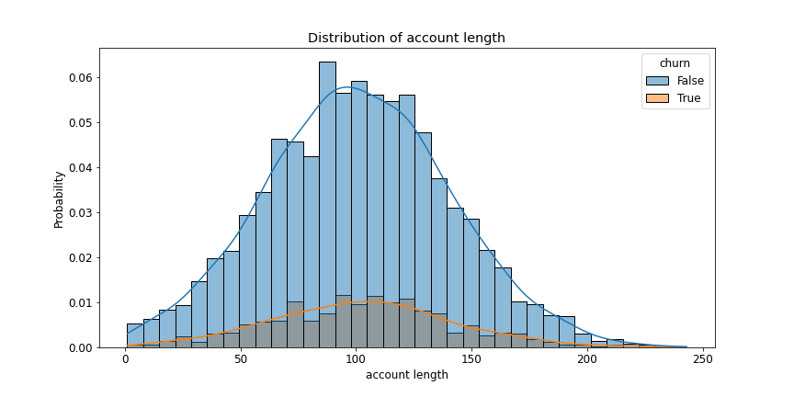
FINDINGS
Account Length(Number of days customer has been with the company) has no effect on churning

Slide 5
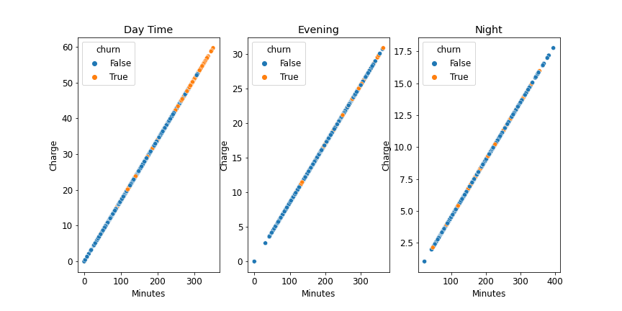
Charges were decreasing as the day goes by( 300 minutes day time =50, evening=22, night=12)
Most churning in day time charges after 250 minutes

Slide 6
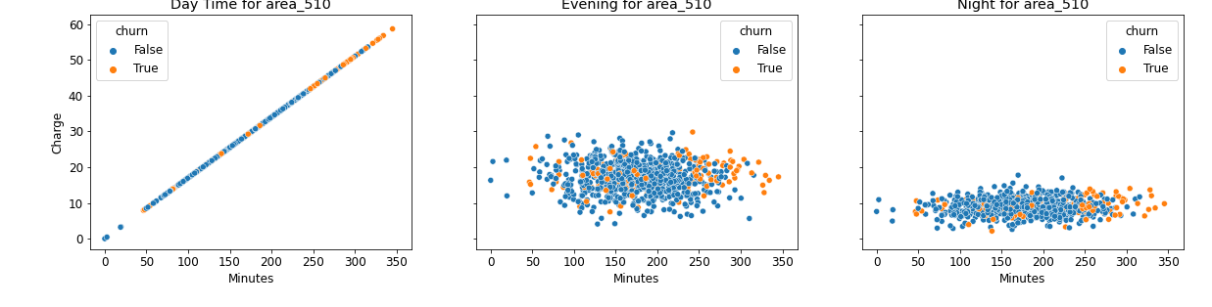
For each area code, after 250 minutes the churning rate is high, even for evening and night hours which have lower charges

Slide 7
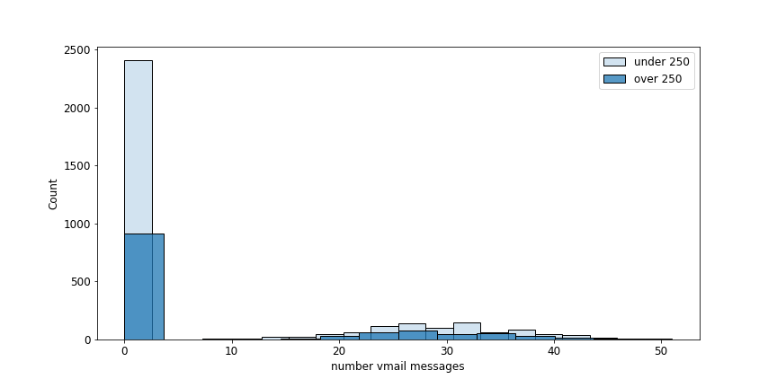
The Less the minutes used(under 250), the more the voice messages sent
Could be those who use more minutes are not sensitized on use of voice mail messages

Slide 8
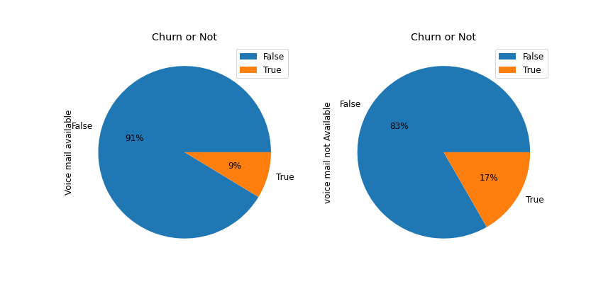
No voice mail plan = higher probability of moving(17% vs 9%)

Slide 9
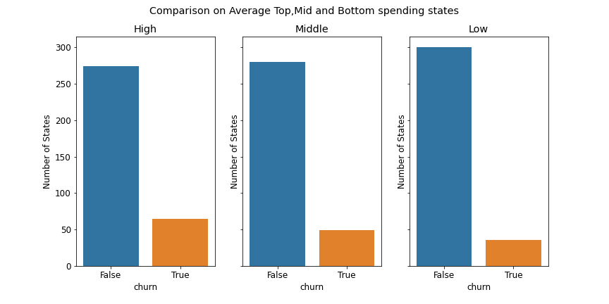
States grouped by amount spent(charges): High(top 5), mid(mid 5),low(bottom 5)
Lower spending states were more loyal and not likely to leave

Slide 10
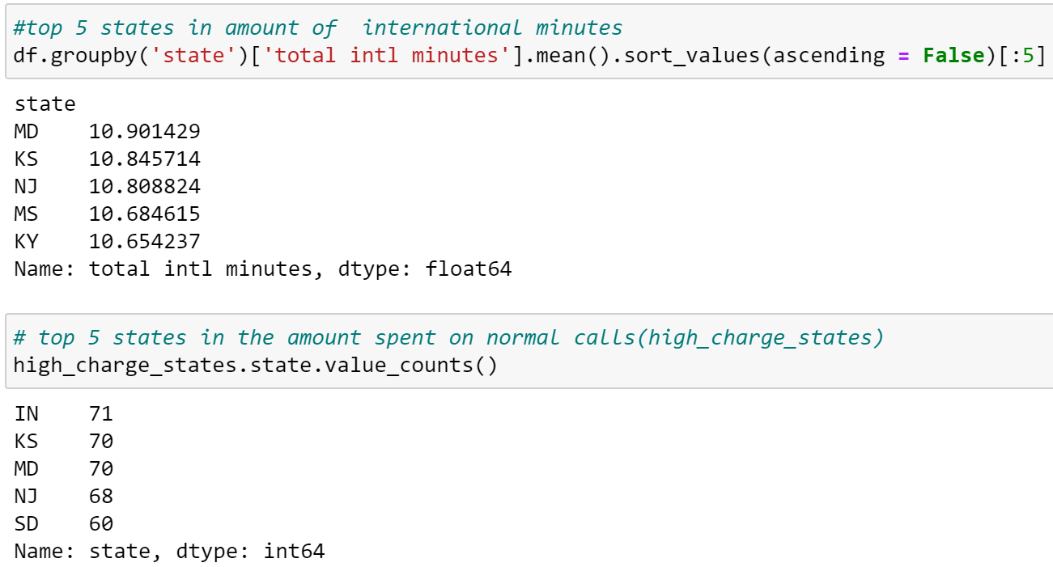
3 states with high international minutes also appear in the list of high spenders in normal calls
International calls are double the price of normal calls, so company should work to retain them

Slide 11
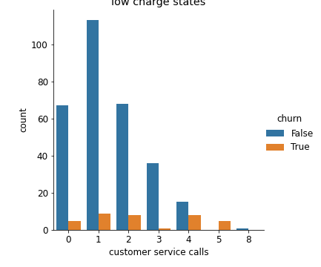
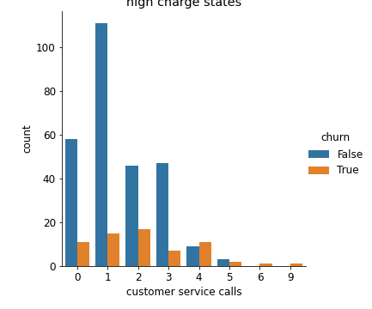
For the same number of customer service calls, there is more churning in the high spending states(lower graph)

Slide 12
RECOMMENDATIONS
Have an incentive for customers who have more than 250 minutes
Sensitize customers on the voice mail plans and their usage
Strategic and Solution oriented customer service to minimize number of calls
Run promotions and incentives on the high spending states for customer retention

Slide 13
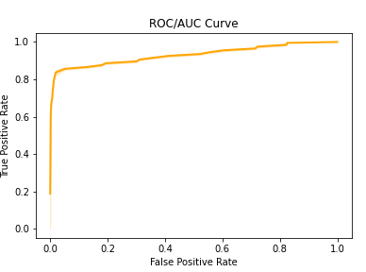
Final Model
Model Accuracy (95.8%) -all correct predictions from the whole data
Model Precision(90%)- If the model predicts that a person churns, there is a 90% chance that they do churn

Slide 14
THANK YOU
Q&A
charitygakuru@gmail.com
Github:wcharity

